Slide 1
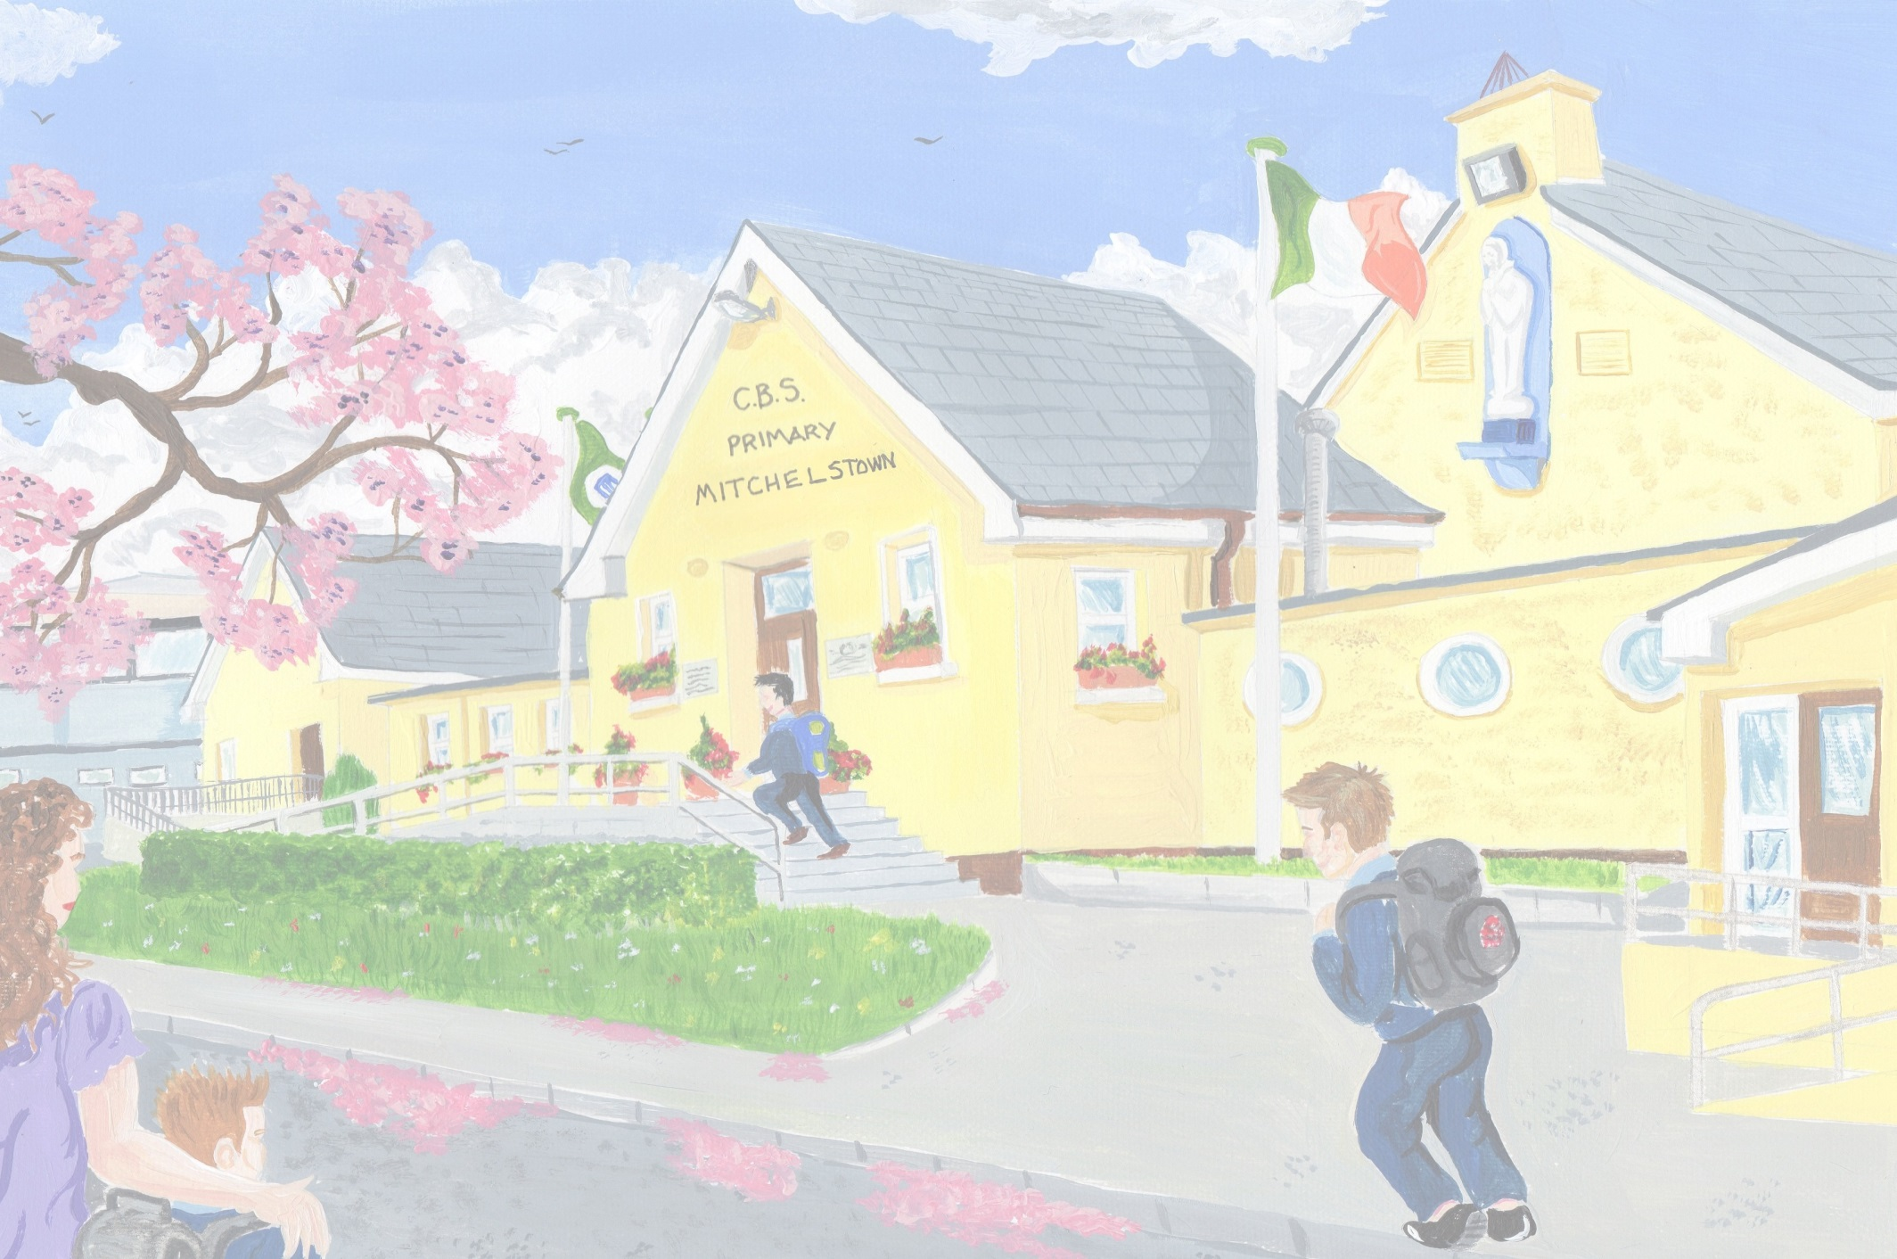
C.B.S. Primary Mitchelstown Health Promoting Schools Committee 2019-2020
C.B.S. Primary Mitchelstown, Health Promoting Schools Committee 2019/20

Slide 3
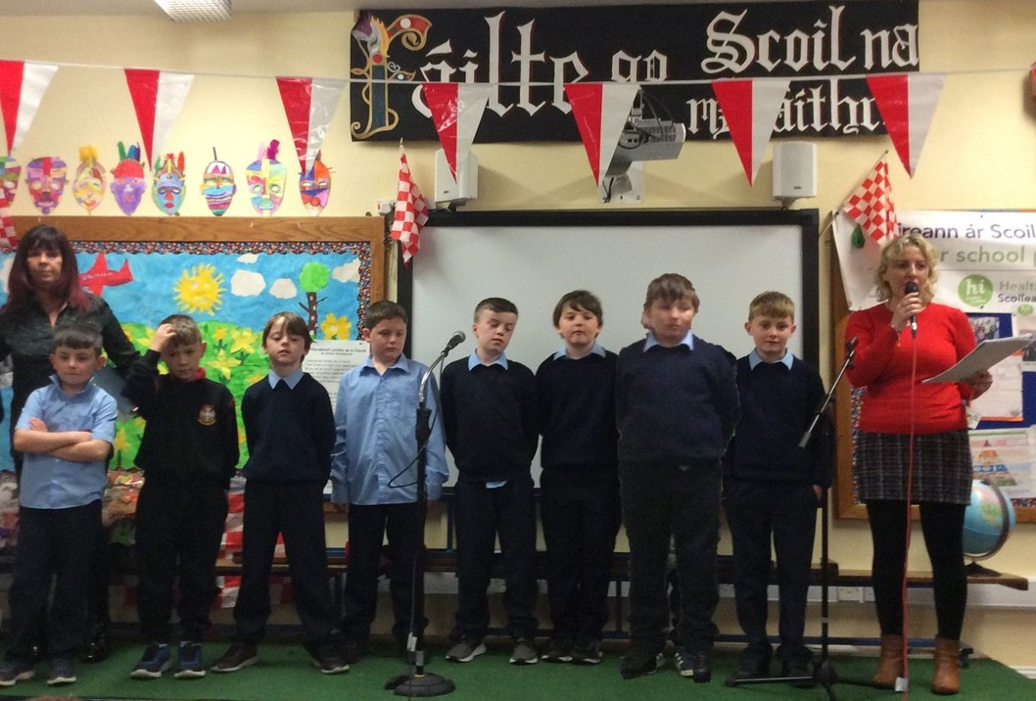
Health Promoting Schools Committee 2019-2020
C.B.S. Primary Mitchelstown, Health Promoting Schools Committee -2019/20

Slide 4
Health Promoting Schools Committee 2019-2020
Ms. O’Gorman’s 1st class-Daryl
Mr. Davoren’s 2nd class-M.J.
Ms. O’Callaghan’s 1st/2nd class-John C.
Ms. Walshe/Ms. Clifford’s 3rd class-Kevin C.
Mr. O’Regan’s 3rd/4th class-Nathan B.
Mr. Coffey’s 4th class-Iarlaith
S Ms. Barry’s 5th class-Cian L +
Mr. Carey’s 5th / 6th class-Seán B.
Mr. Weir’s 6th class-Aidan
C.B.S. Primary Mitchelstown, Health Promoting Schools Committee 2019/20

Slide 5
Health Promoting Schools Staff co-ordinators 2019-2020
Ms. O’Regan Ms.O’Callaghan Ms.Barry
Ms.Keane
Ms. McGrath
Ms. Baker

Slide 6
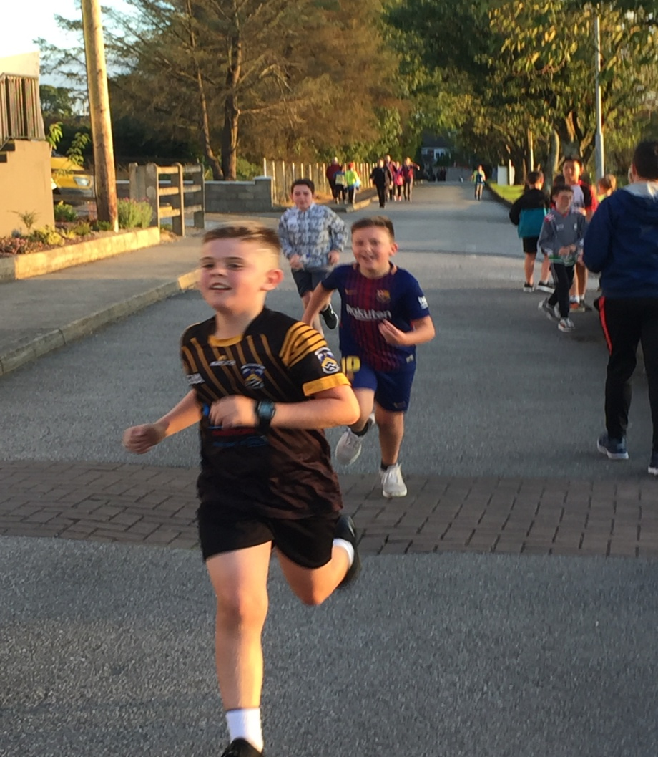
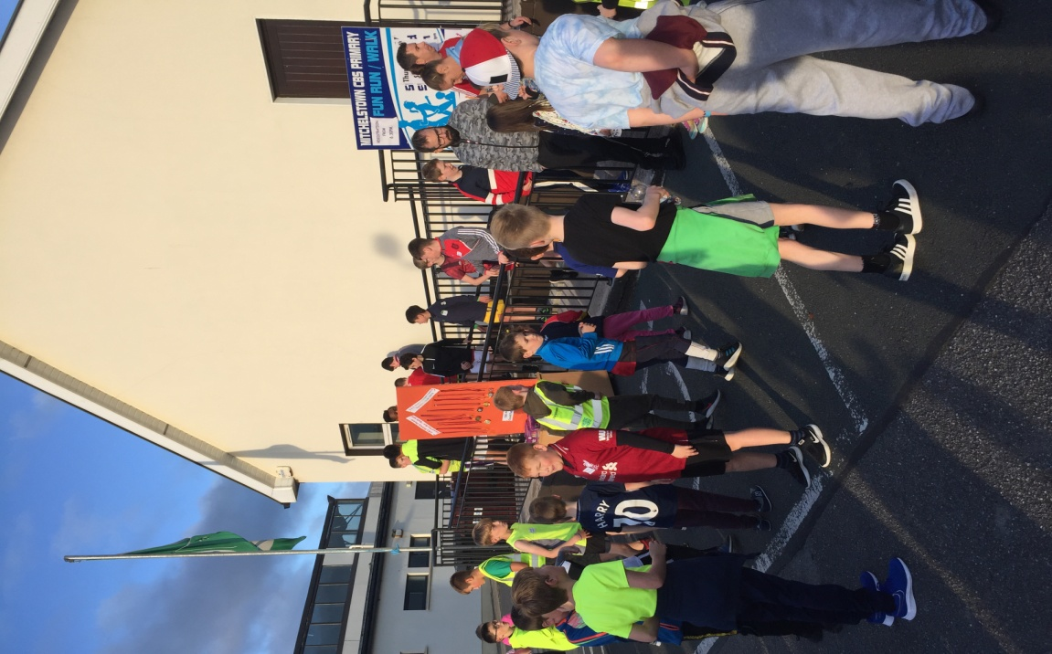
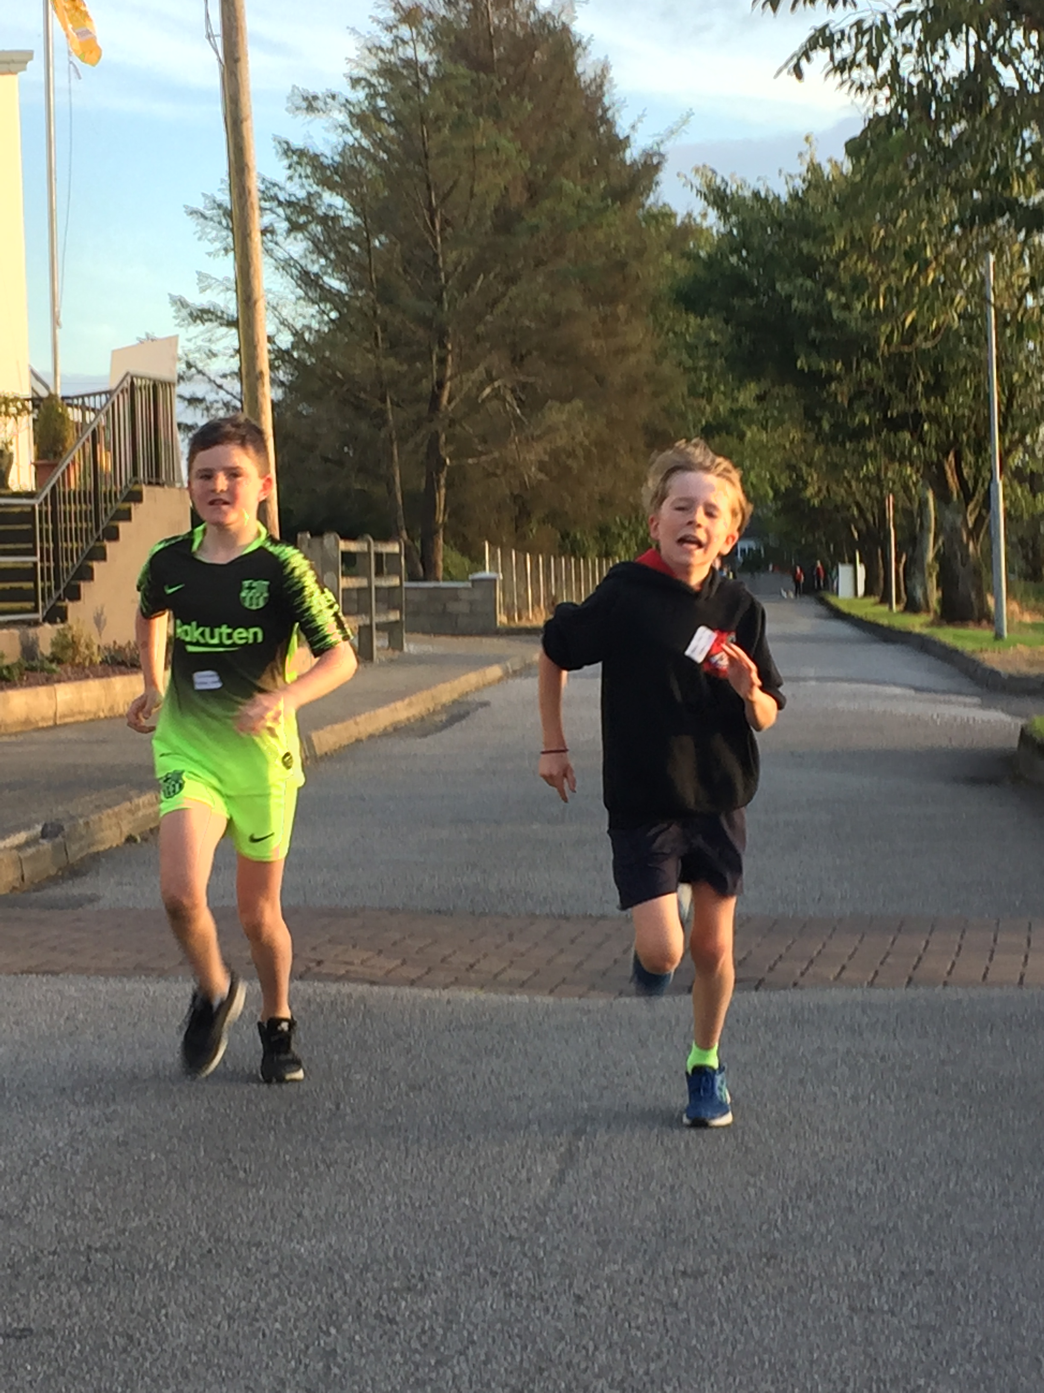
5km Fun Run
C.B.S. Primary Mitchelstown, Health Promoting Schools Committee 2019/20

Slide 7
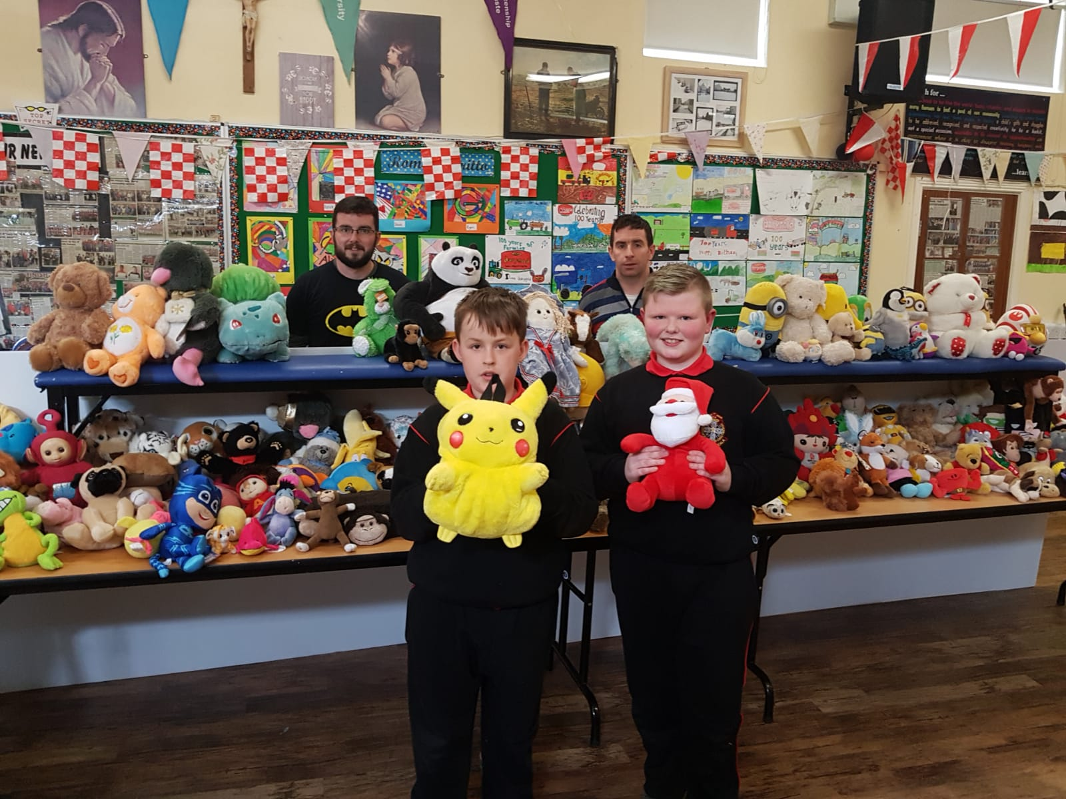
Helping others with the Niall Melon Foundation Teddy Bear Appeal.
C.B.S. Primary Mitchelstown, Health Promoting Schools Committee 2019/20

Slide 8
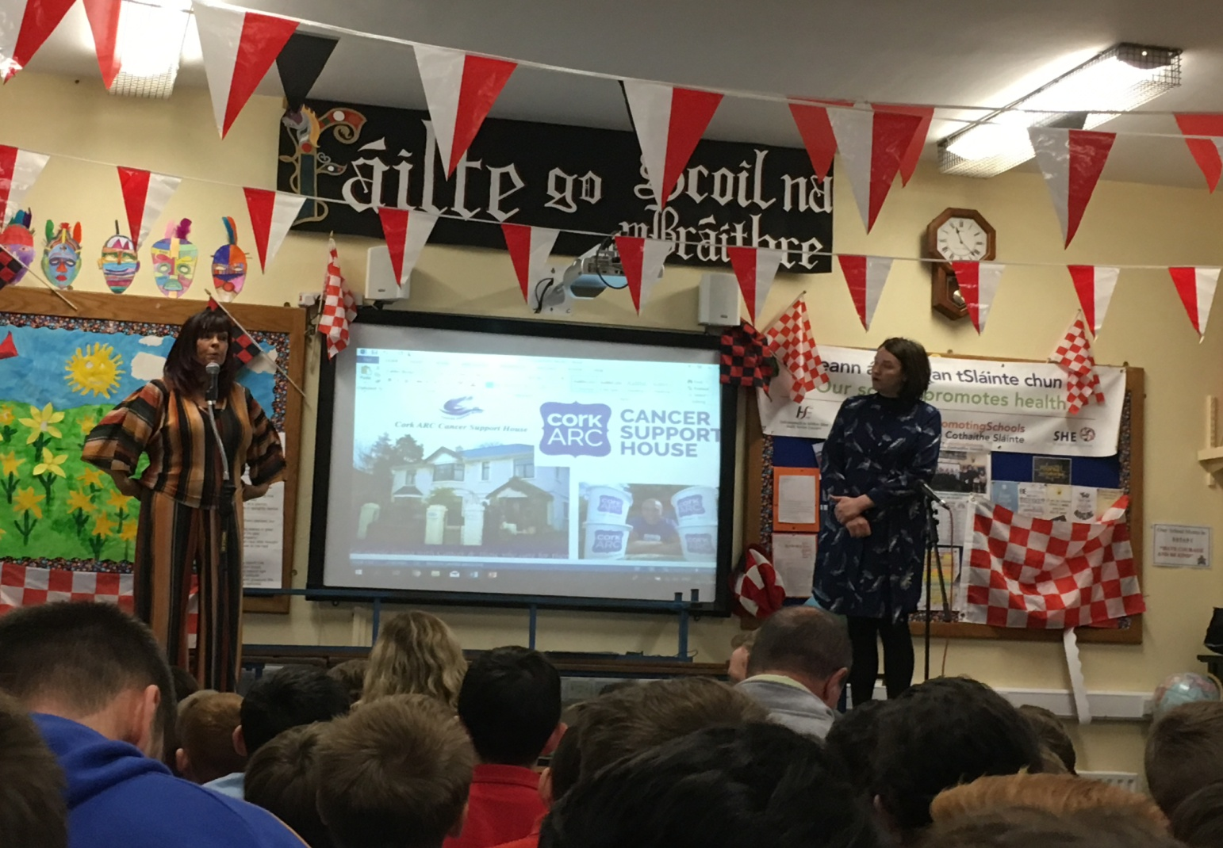
Helping others with ARC house
We raised 1,250 euro
C.B.S. Primary Mitchelstown, Health Promoting Schools Committee 2019/20

Slide 9
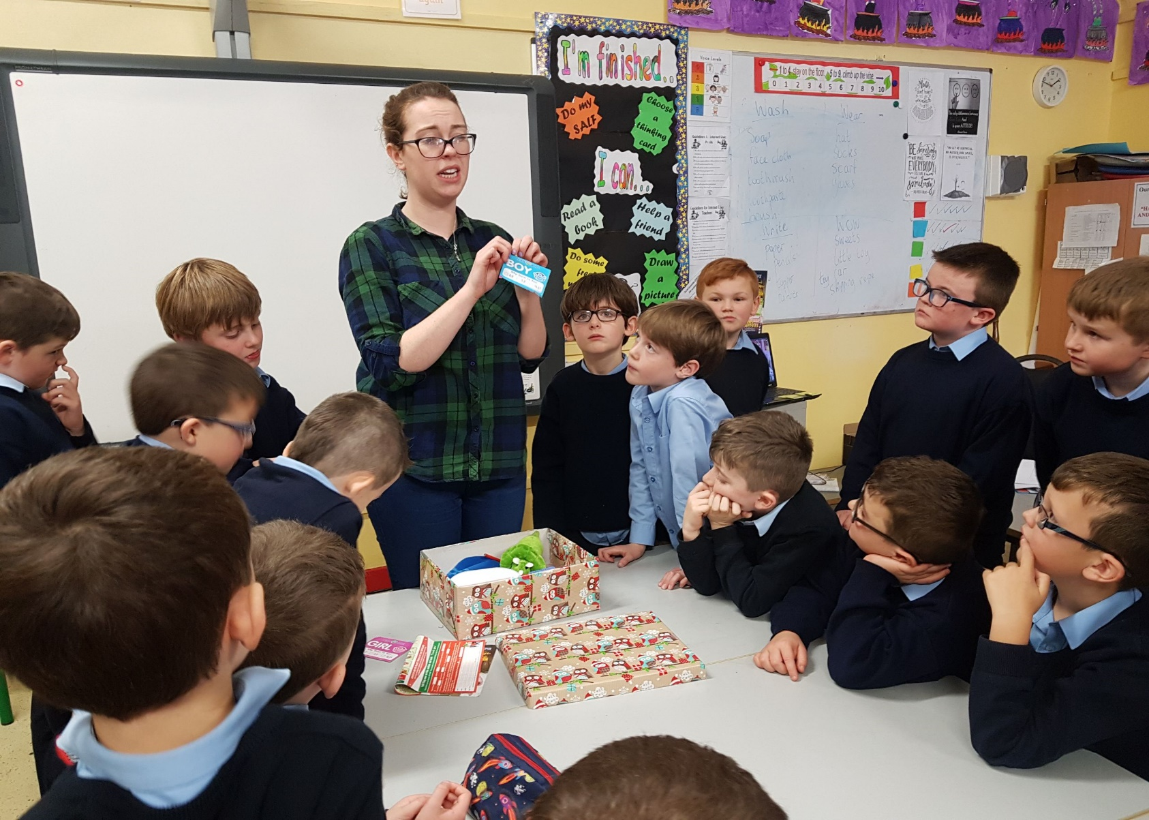
Helping others with the
C.B.S. Primary Mitchelstown, Health Promoting Schools Committee 2019/20

Slide 11
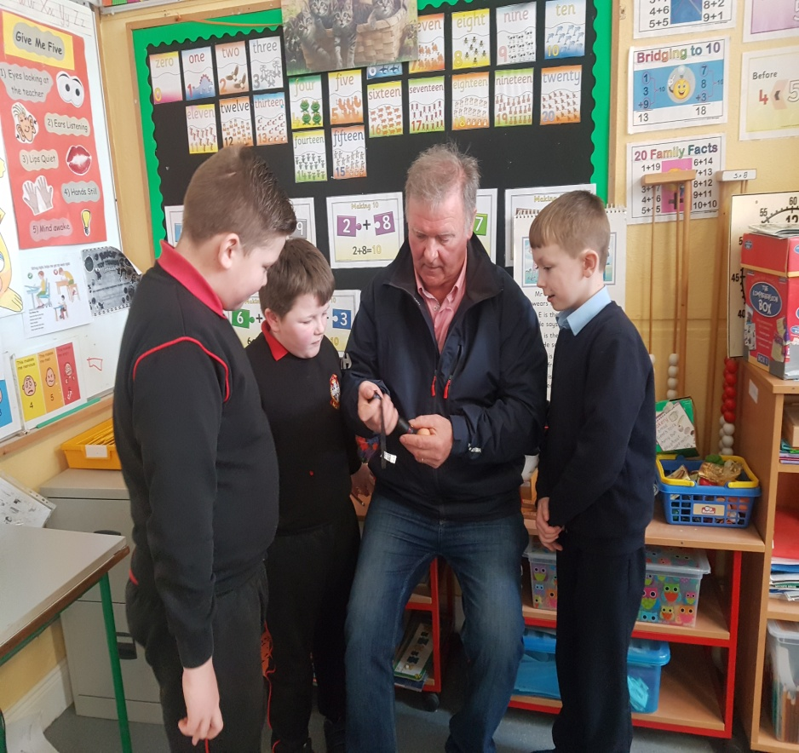
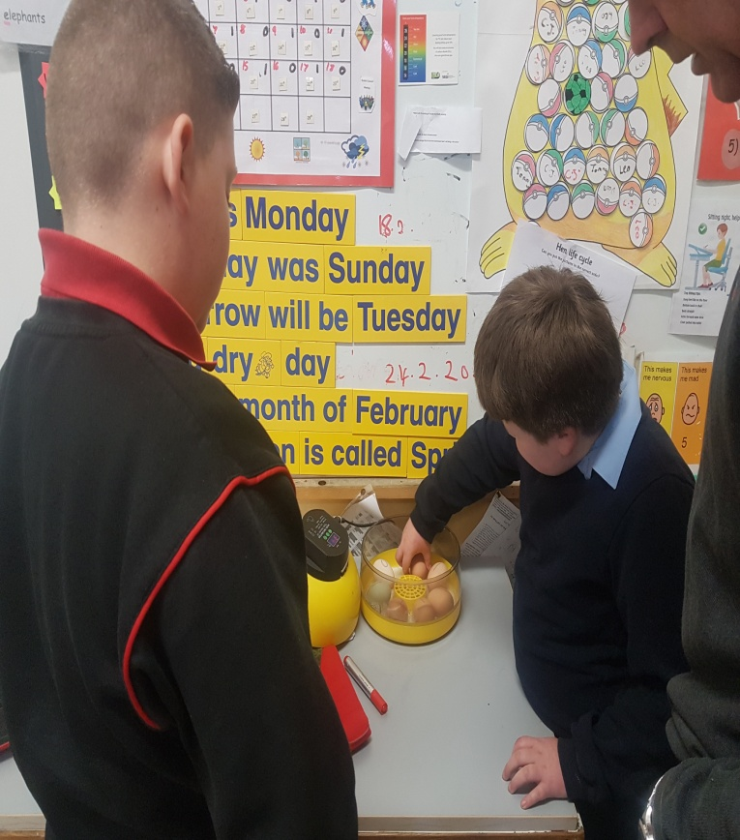
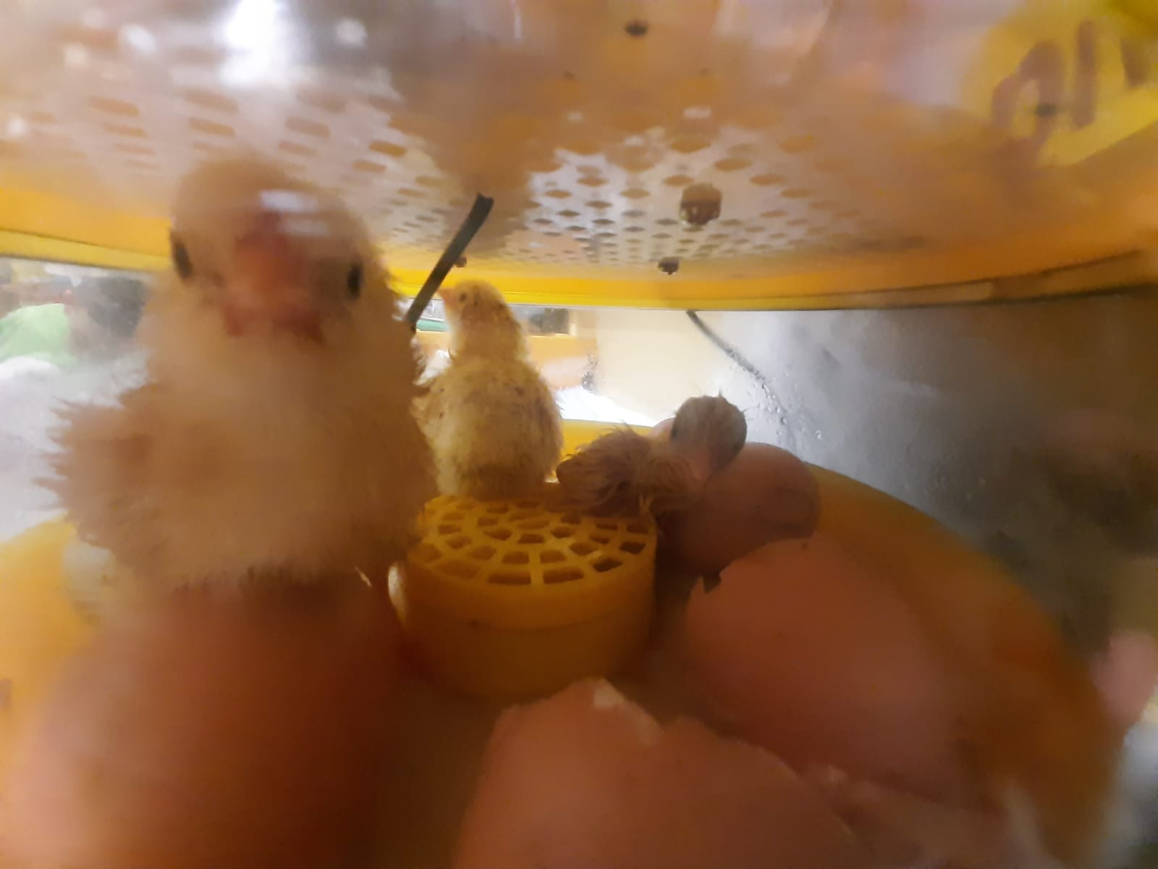
Hatching chicks
C.B.S. Primary Mitchelstown, Health Promoting School 2019/20

Slide 12
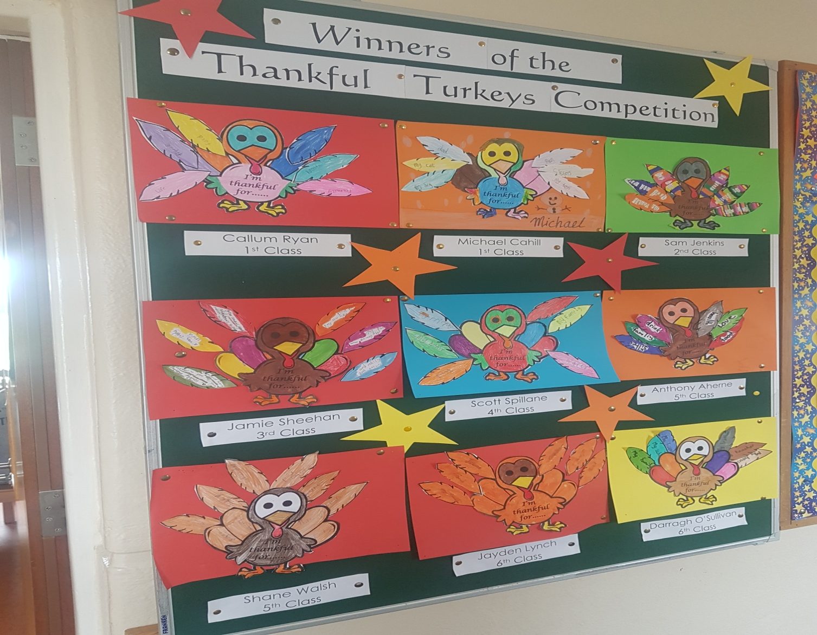
Thankful Turkey Competition winners
C.B.S. Primary Mitchelstown, Health Promoting Schools Committee 2019/20

Slide 13
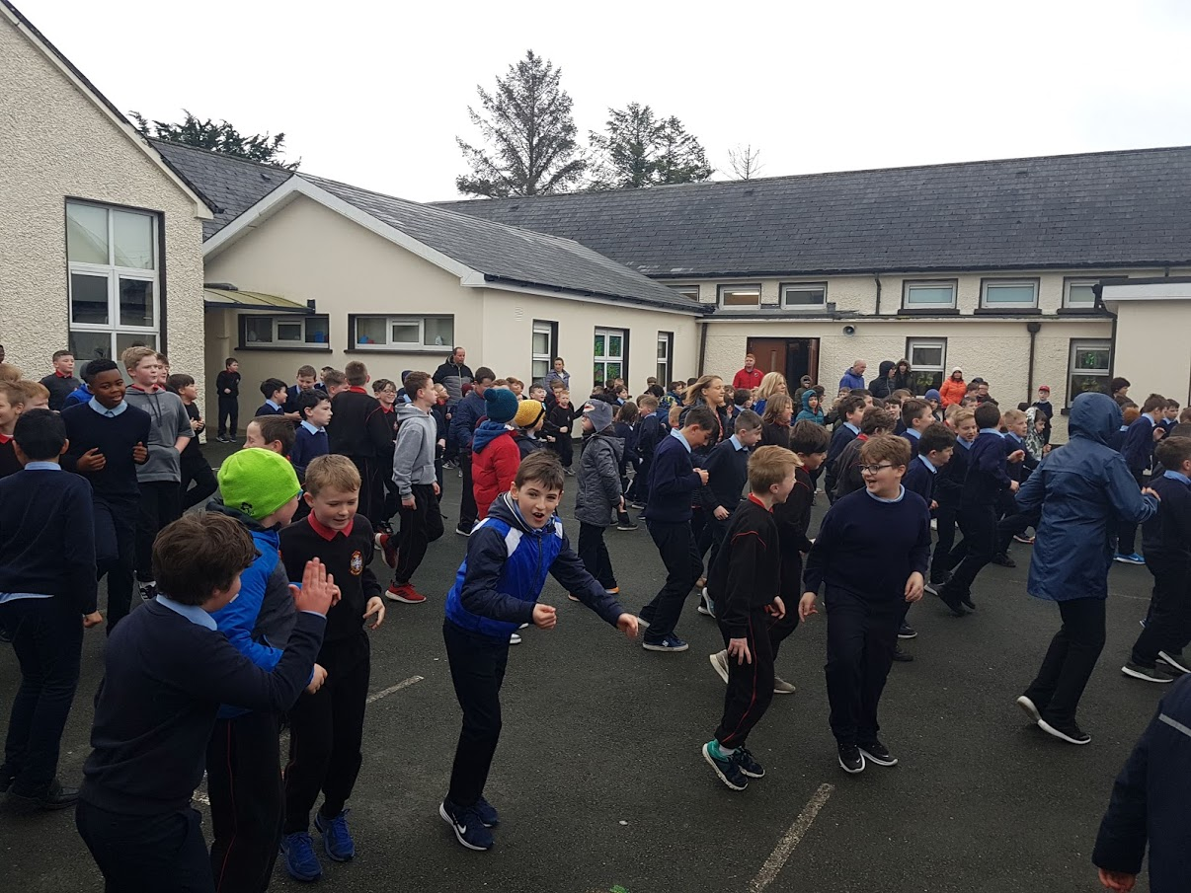
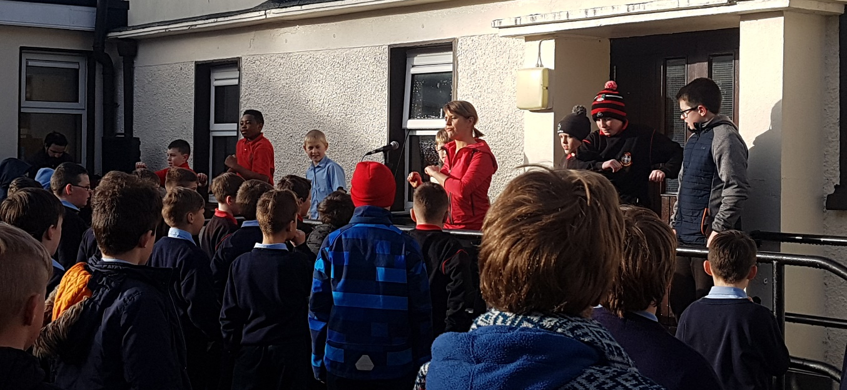
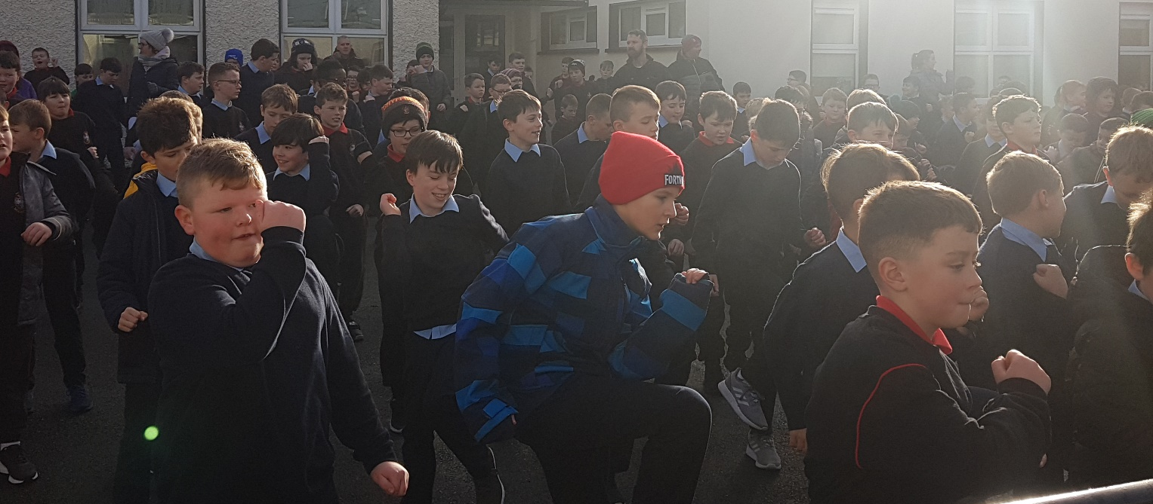
C.B.S. Primary Mitchelstown, Health Promoting Schools Committee 2019/20

Slide 14
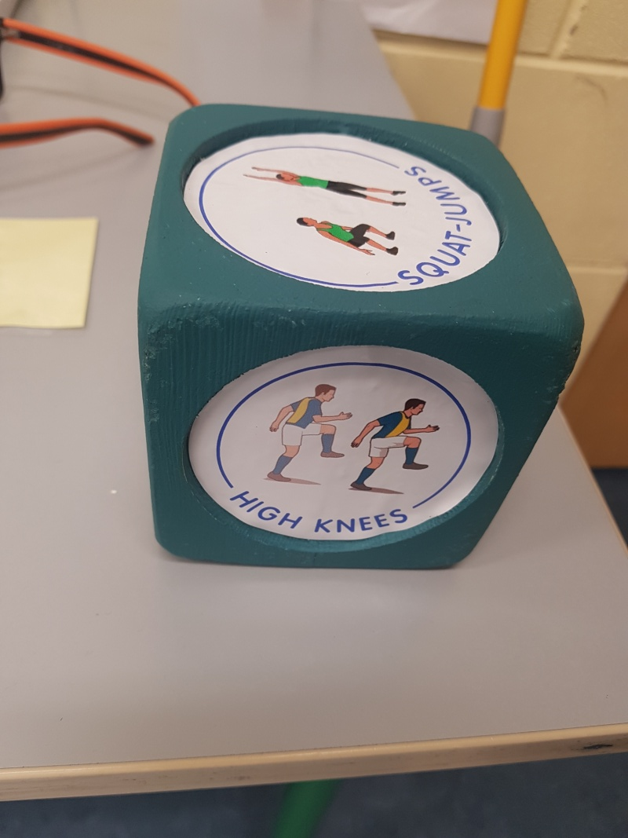
Exercise cubes made by C.B.S. Secondary School students.

Slide 15
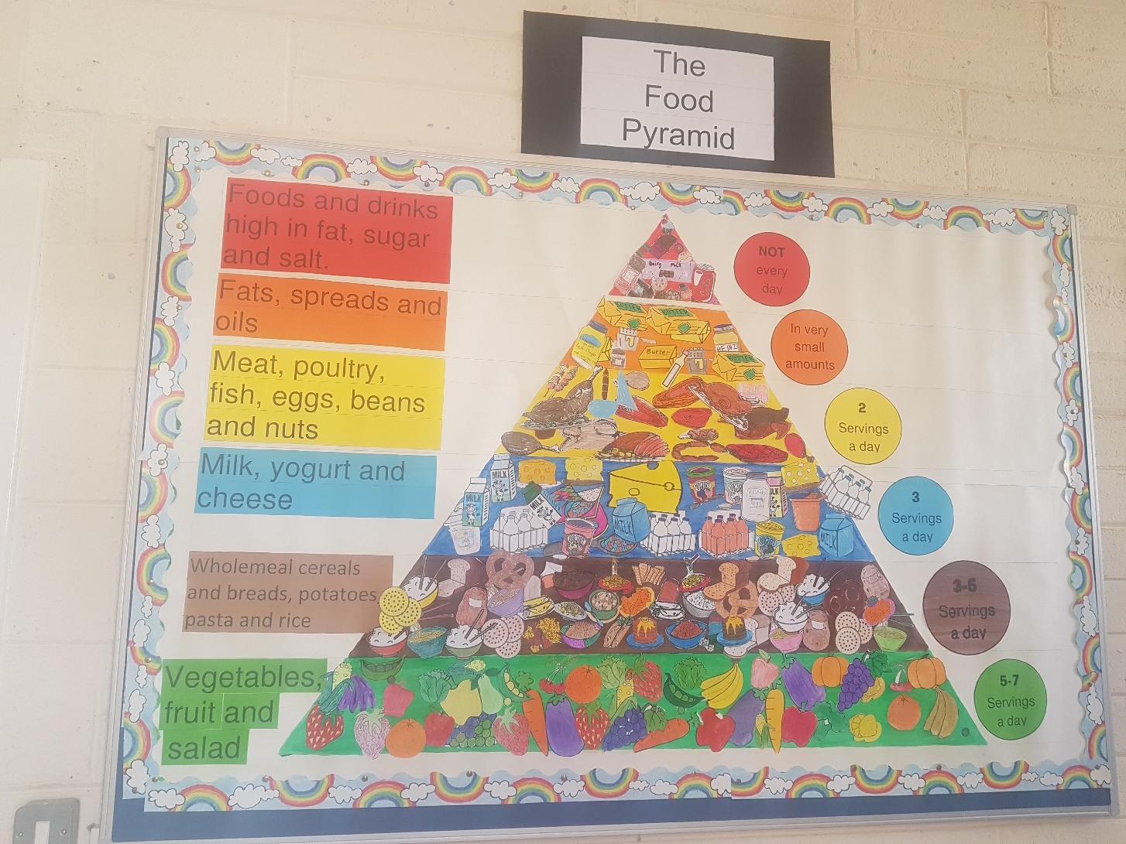
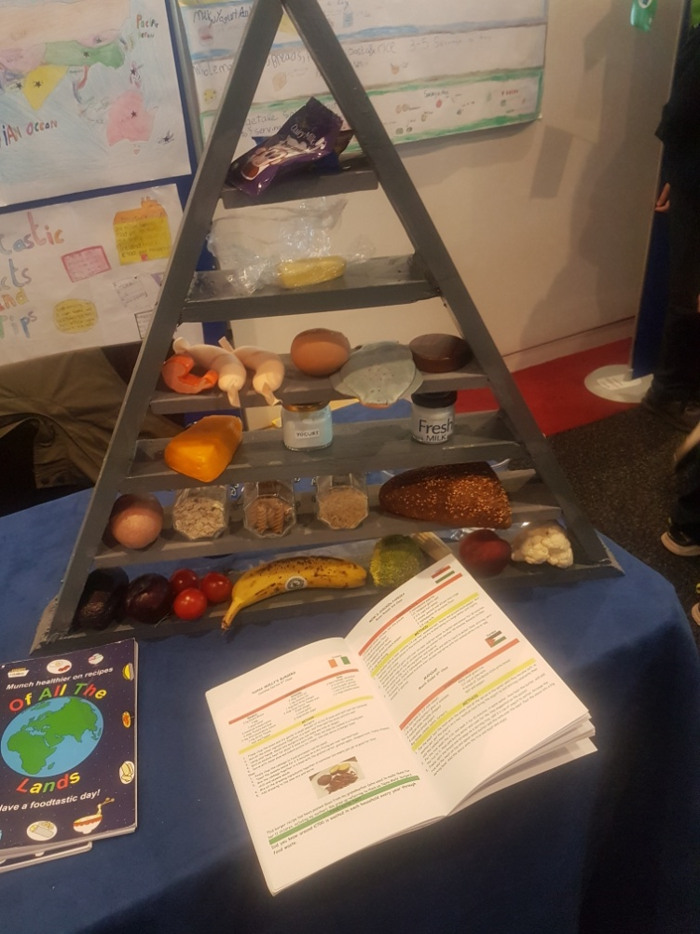
Ms. Barry’s 5th Class Food Pyramid display
C.B.S. Primary Mitchelstown, Health Promoting Schools Committee 2019/20

Slide 16
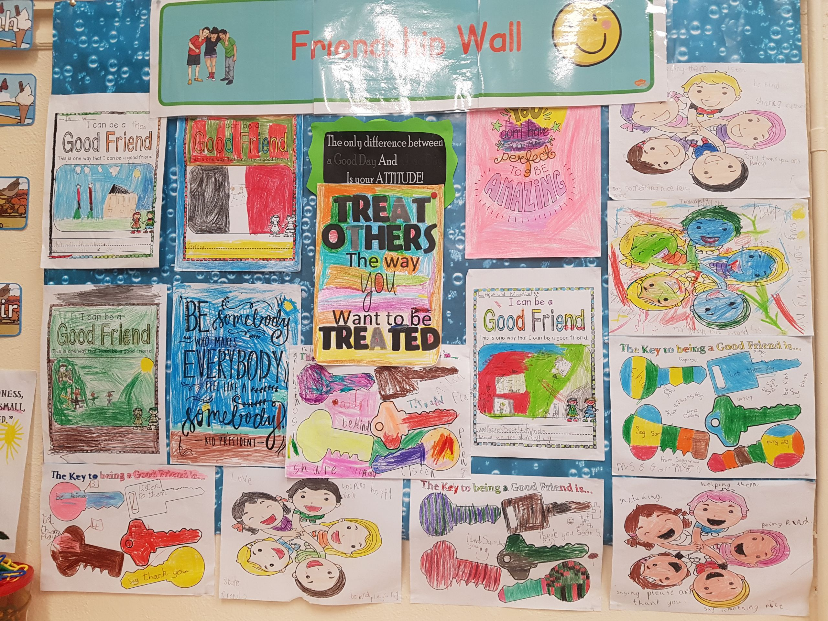
Ms.O’Gorman’s 1st class Friendship Wall
C.B.S. Primary Mitchelstown, Health Promoting Schools Committee 2019/20

Slide 17
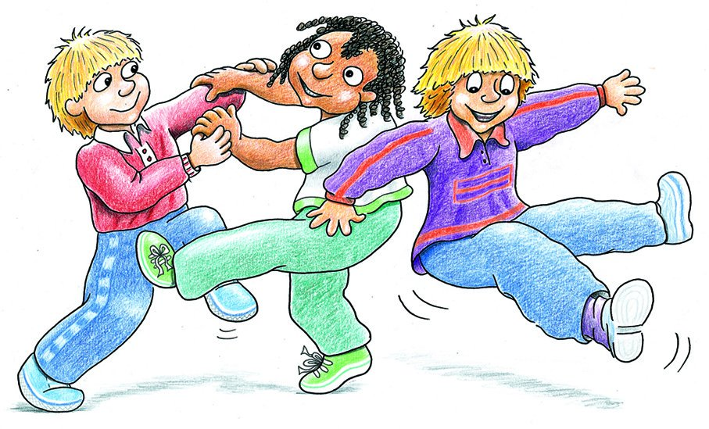
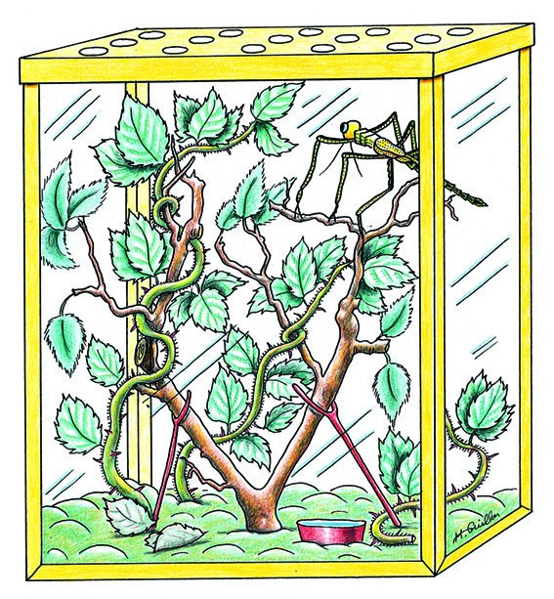
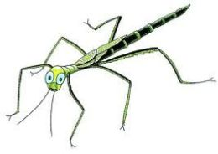
Zippy’s Friends
C.B.S. Primary Mitchelstown, Health Promoting Schools Committee 2019/20

Slide 18
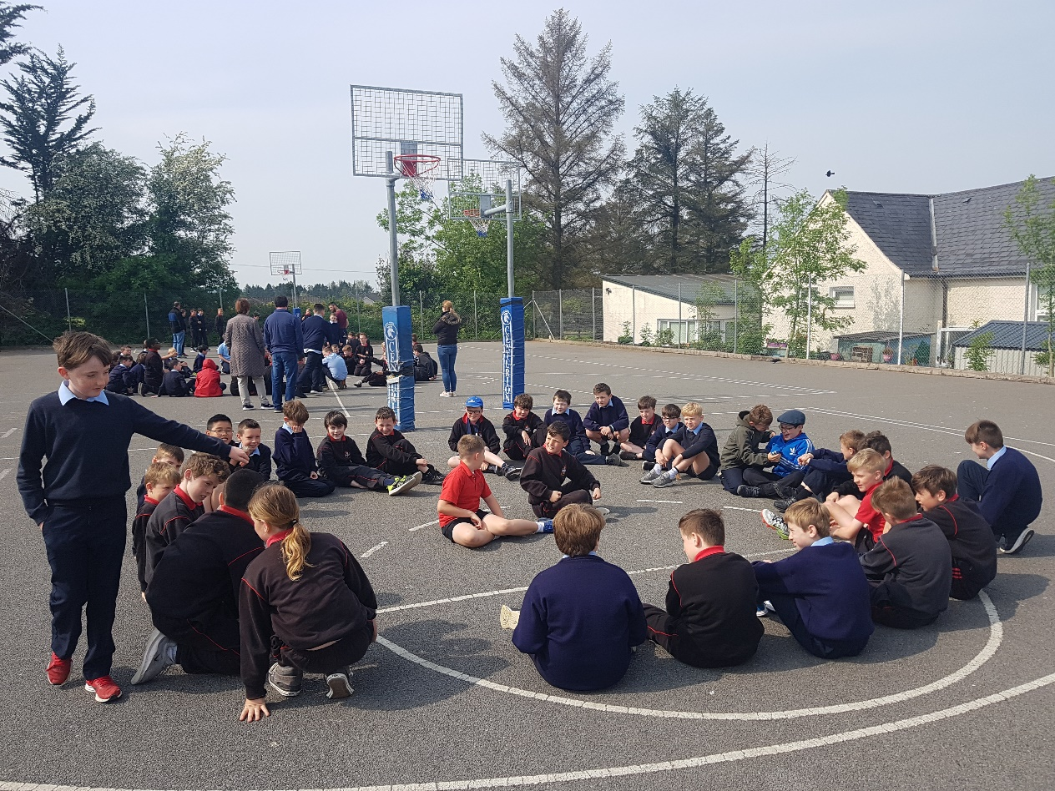
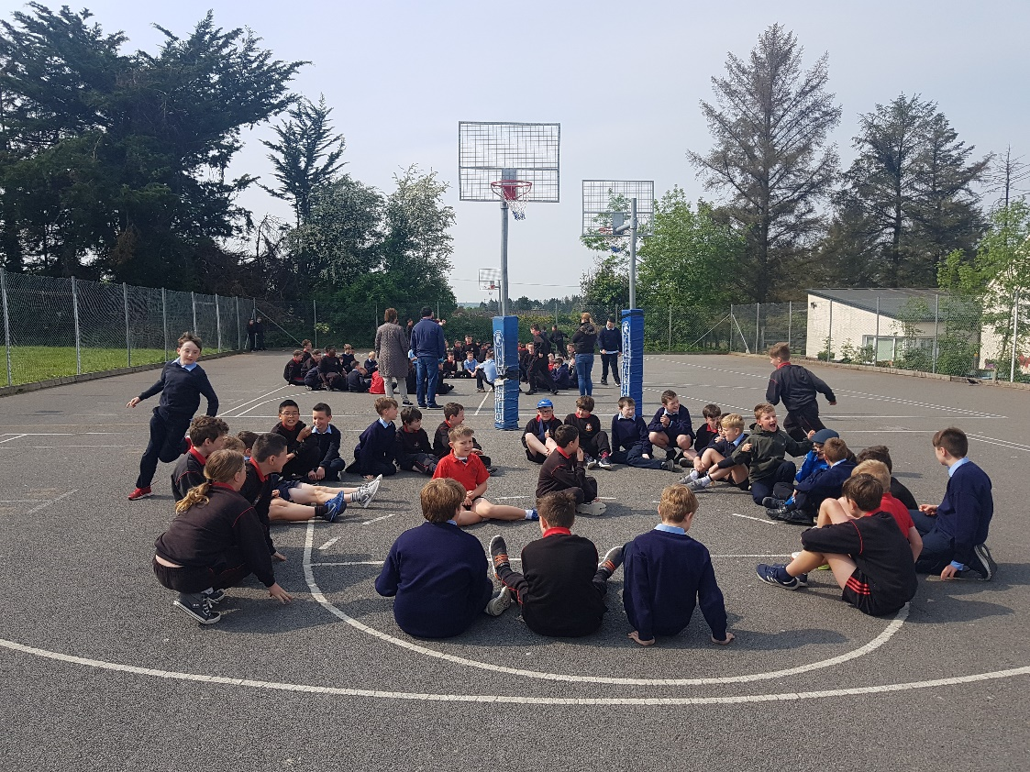
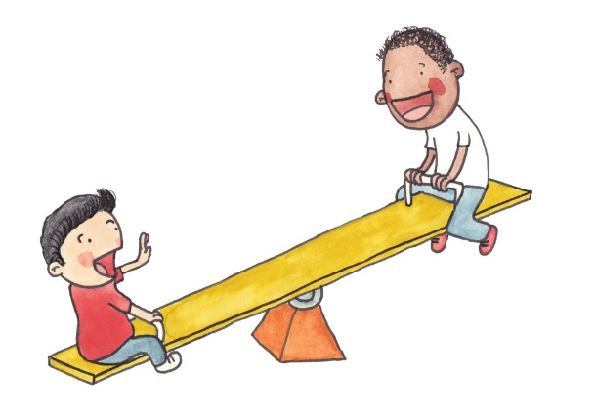
Playground Games
C.B.S. Primary Mitchelstown, Health Promoting Schools Committee 2019/20

Slide 19
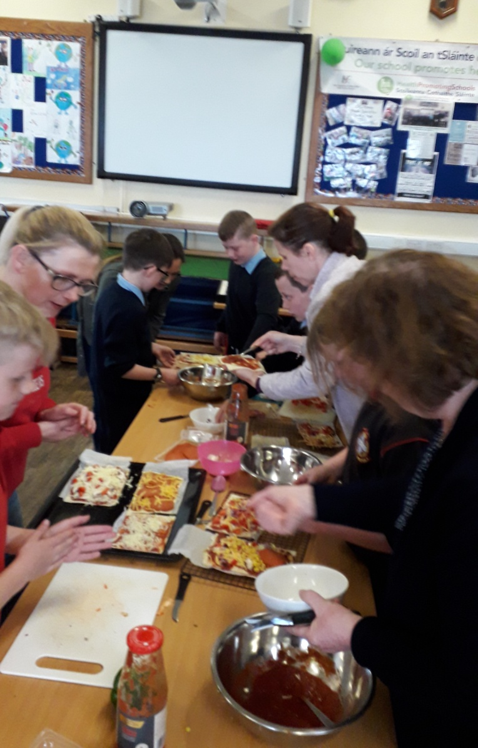
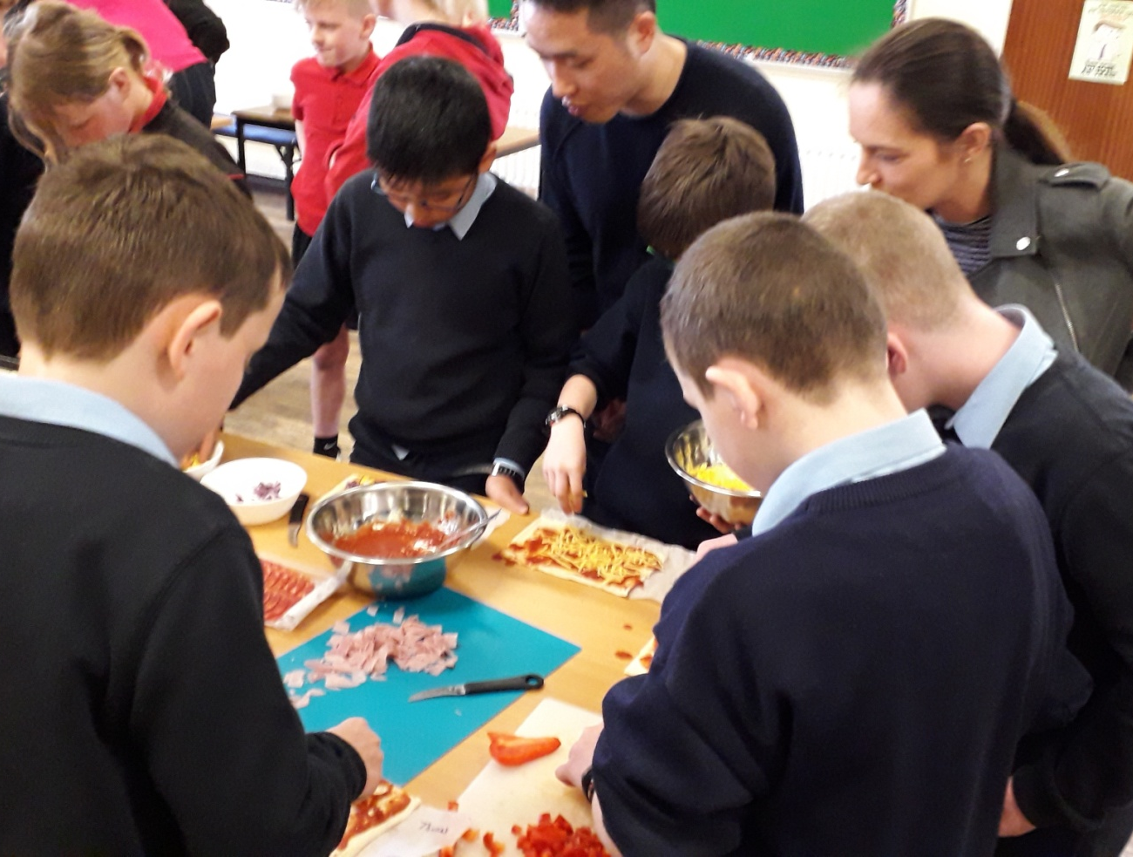
After School Healthy Cooking Programme
C.B.S. Primary Mitchelstown, Health Promoting Schools Committee 2019/20

Slide 20
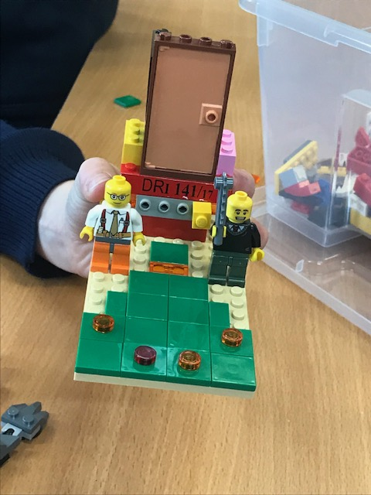
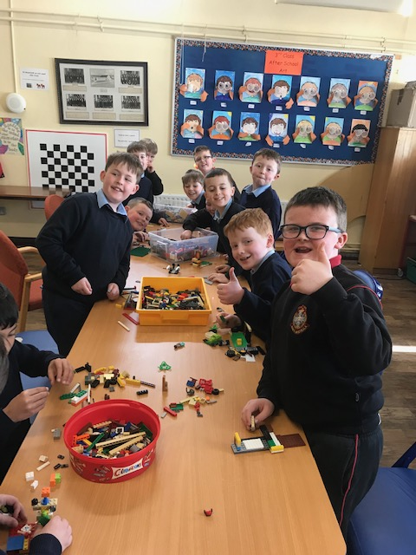
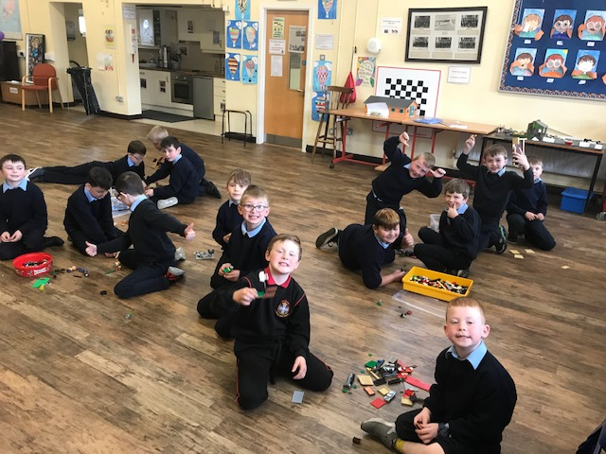
C.B.S. Primary Mitchelstown, Health Promoting Schools Committee 2019/20

Slide 21
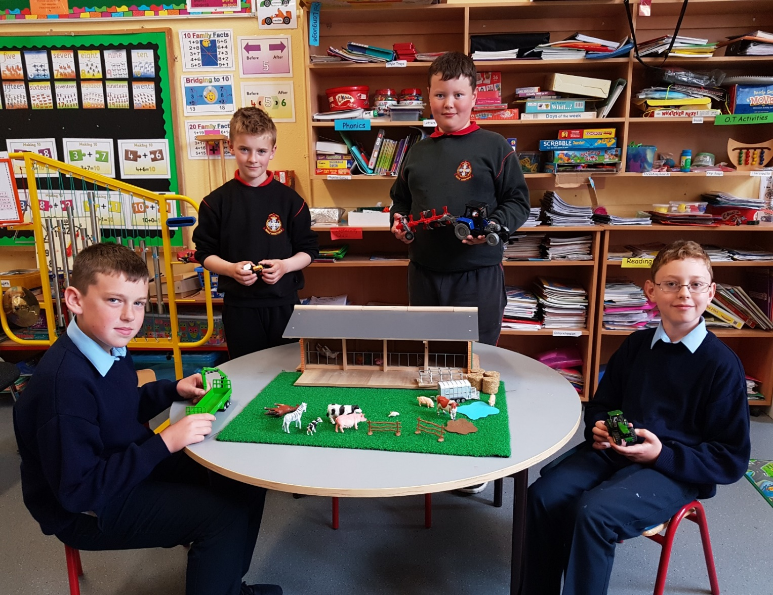
Tractor Club
C.B.S. Primary Mitchelstown, Health Promoting Schools Committee 2019/20

Slide 22
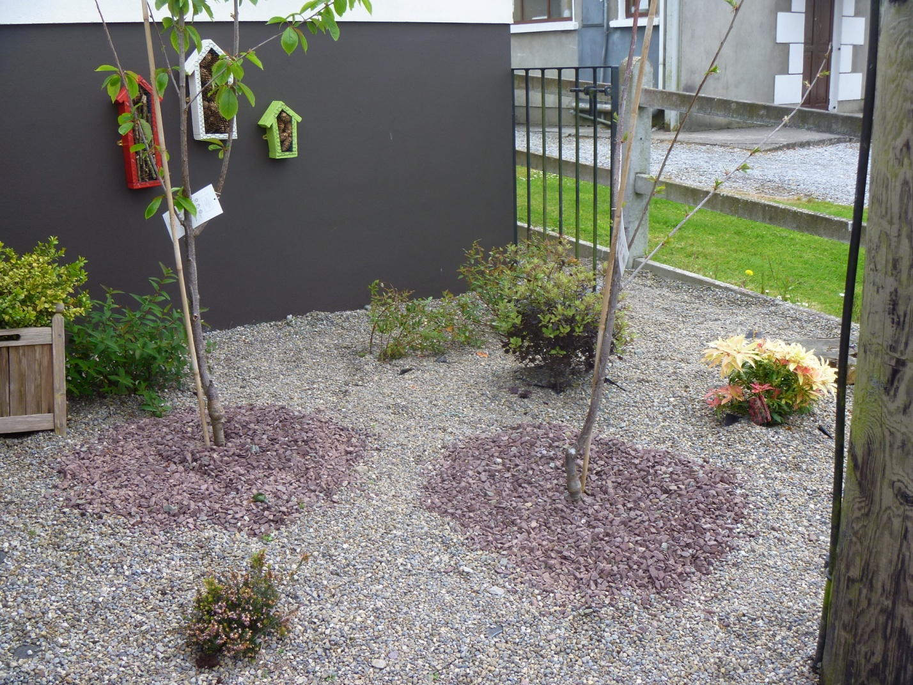
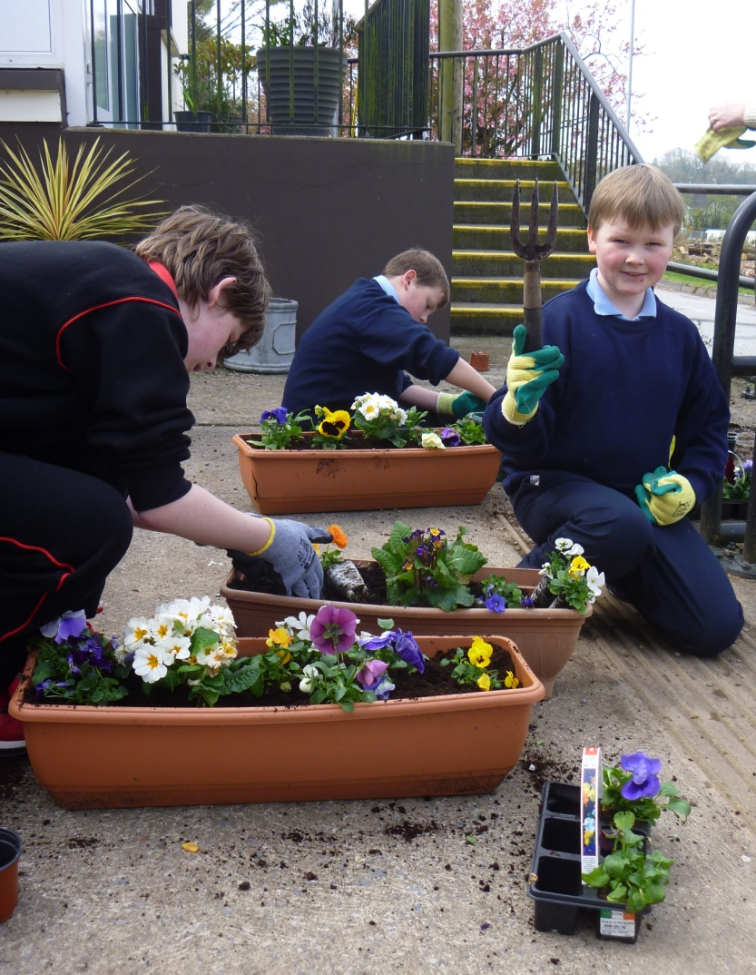
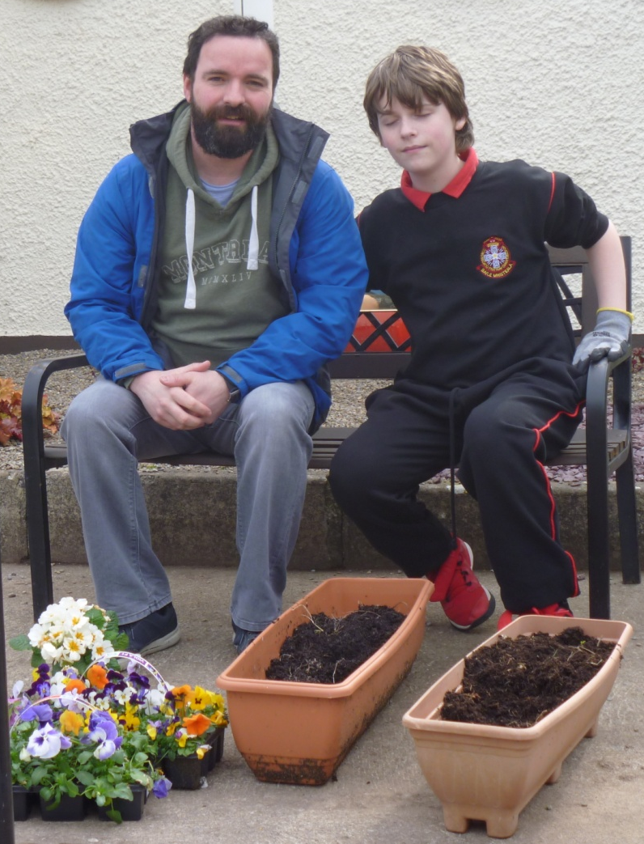
School Garden
C.B.S. Primary Mitchelstown, Health Promoting Schools Committee 2019/20

Slide 23
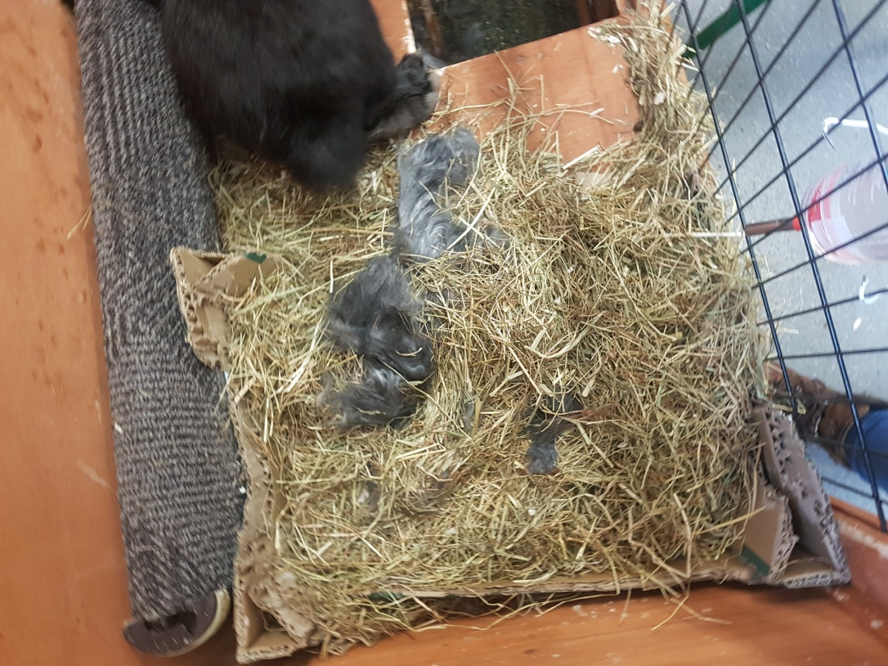
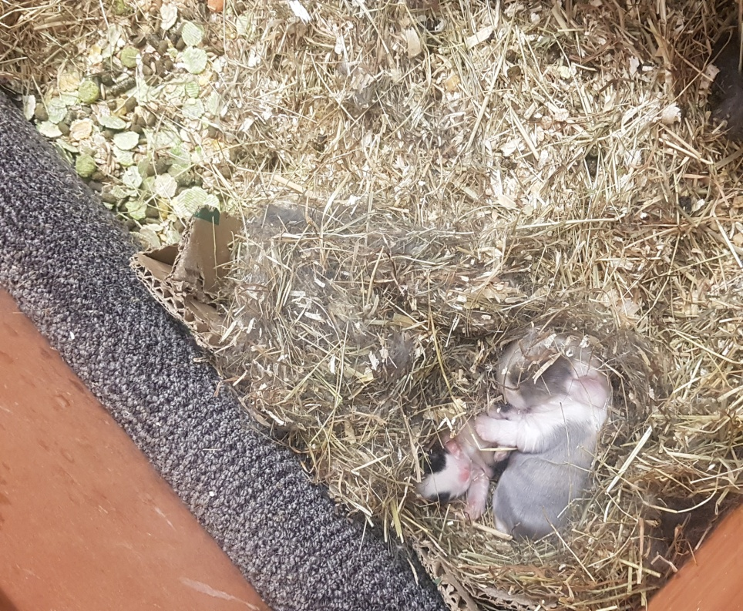
Baby Bunnies
Black Jack made a nest from hay and her own fur and had 2 beautiful babies.
C.B.S. Primary Mitchelstown, Health Promoting Schools Committee 2019/20

Slide 24
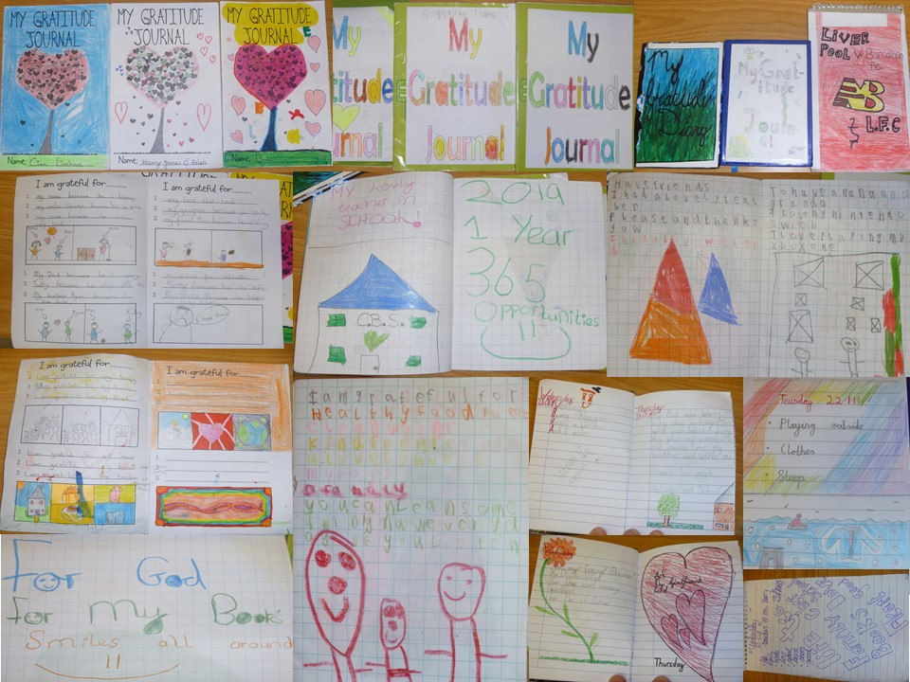
Our Gratitude Journals
C.B.S. Primary Mitchelstown, Health Promoting School 2019/20

Slide 25
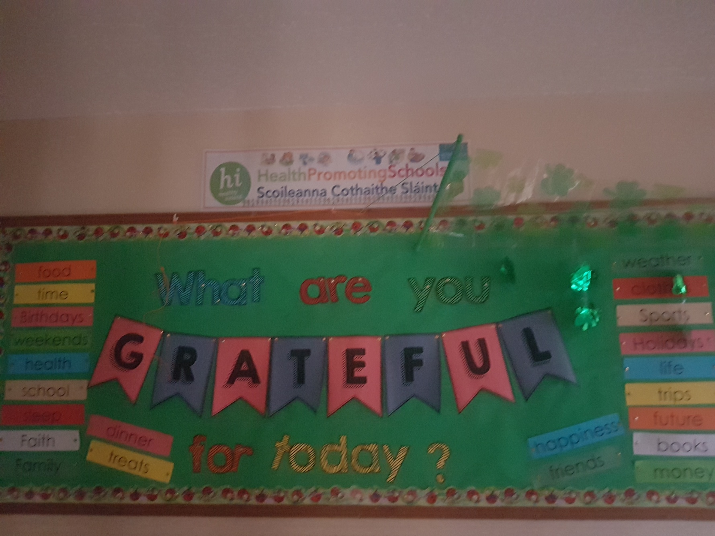

Slide 26
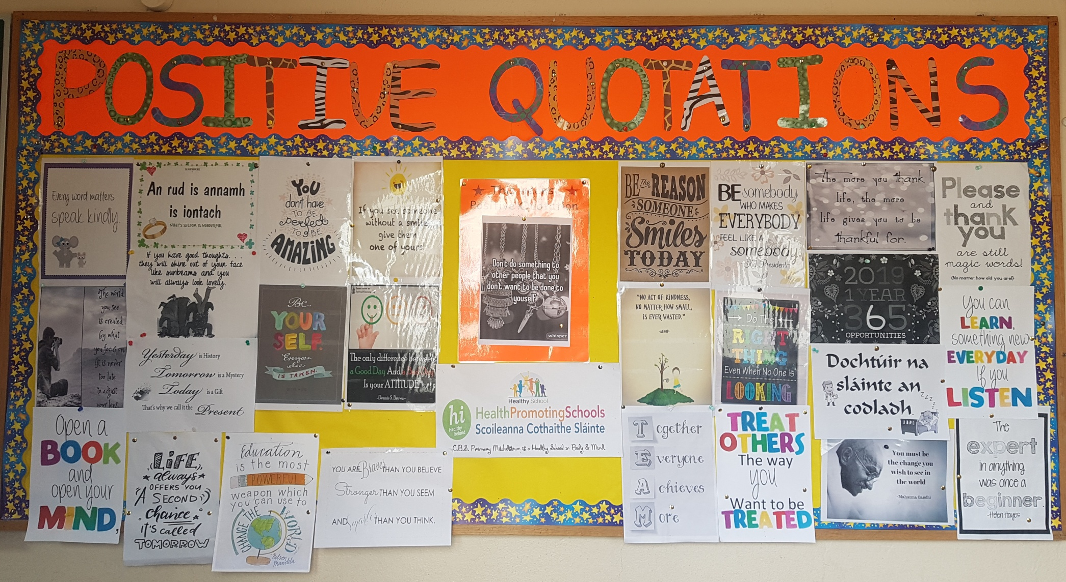
Positive Quotations Display Board
C.B.S. Primary Mitchelstown, Health Promoting School 2019/20

Slide 27
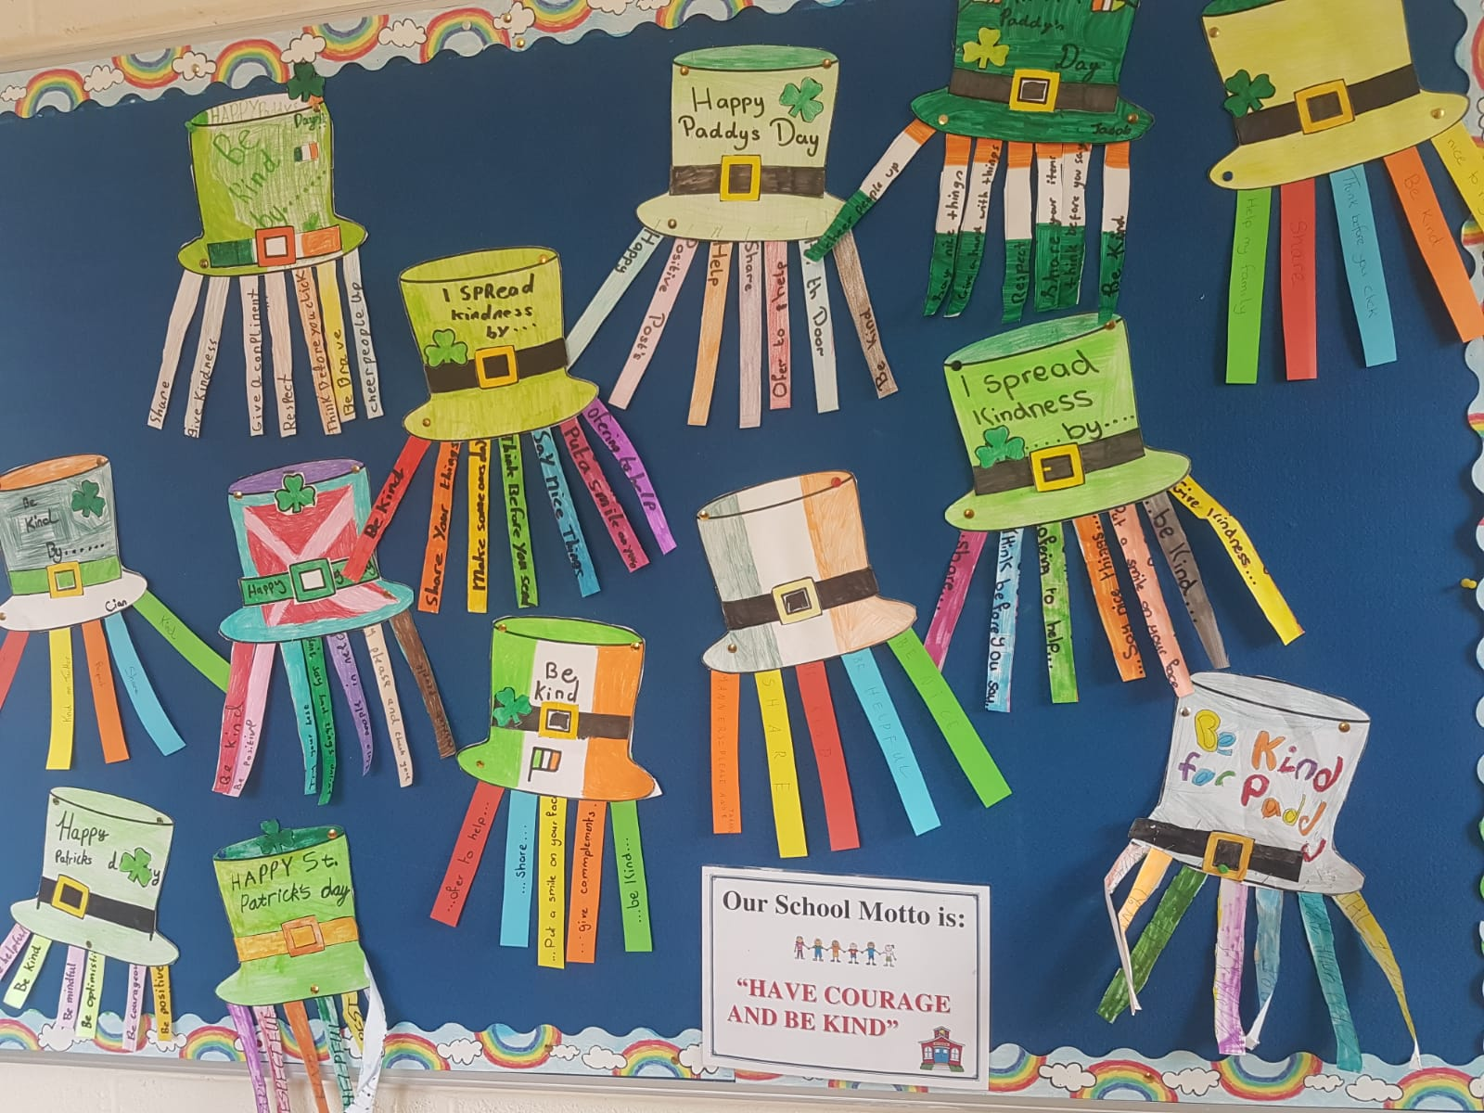
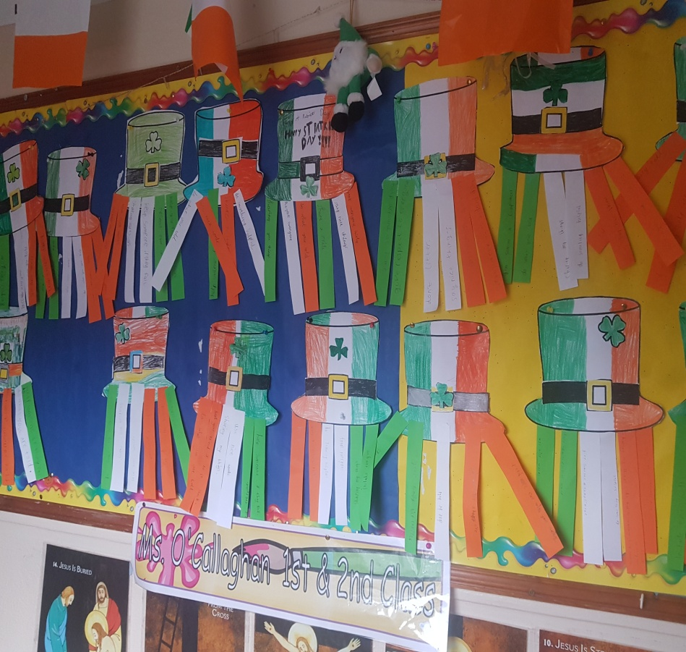
I show kindness by ......

Slide 28
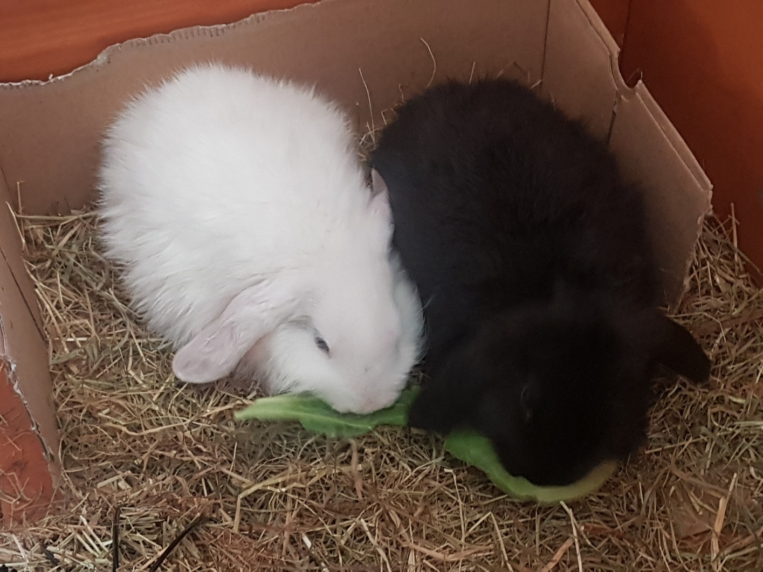
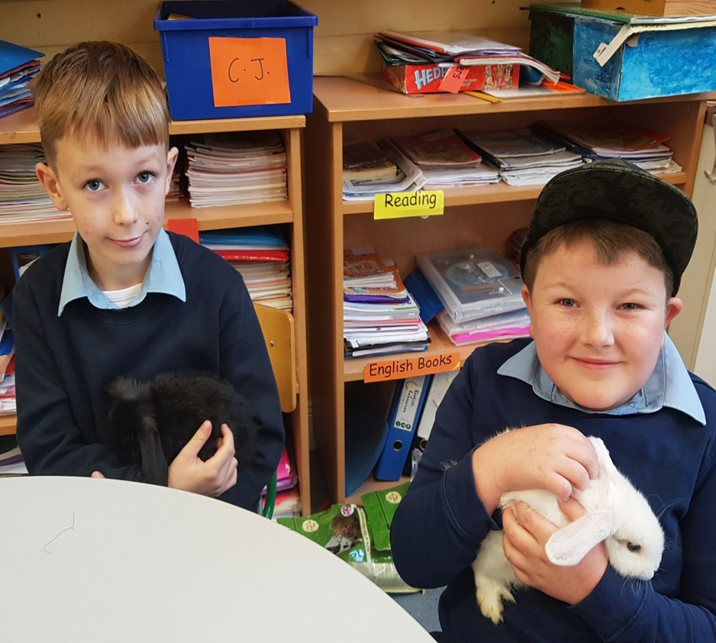
Snowball and Black Jack, our school rabbits
C.B.S. Primary Mitchelstown, Health Promoting School 2019/20

Slide 30
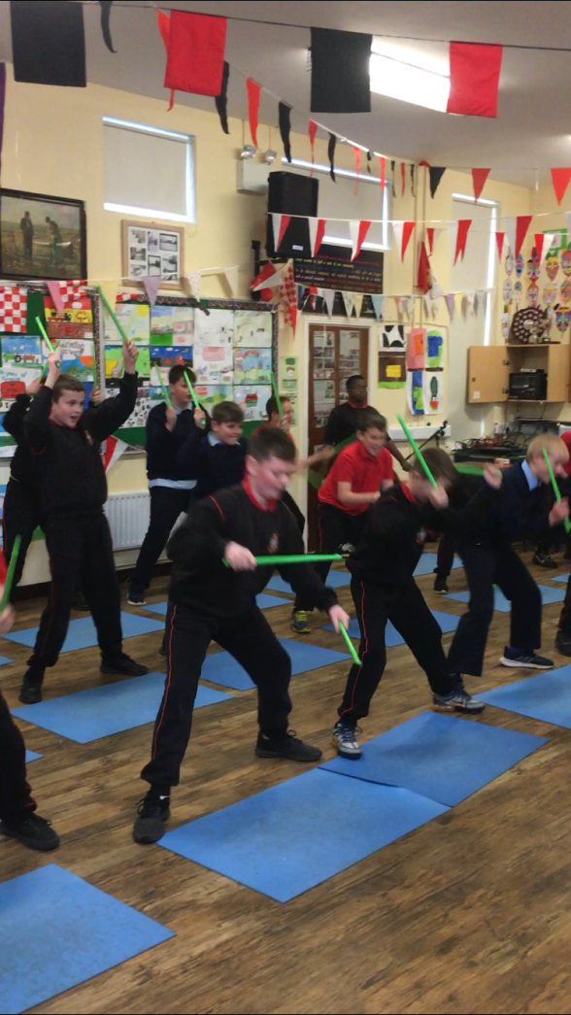
Pound classes with Aine

Slide 31
We remember our loved ones in heaven
Thank you Ms.Keane for the beautiful display.

Slide 33
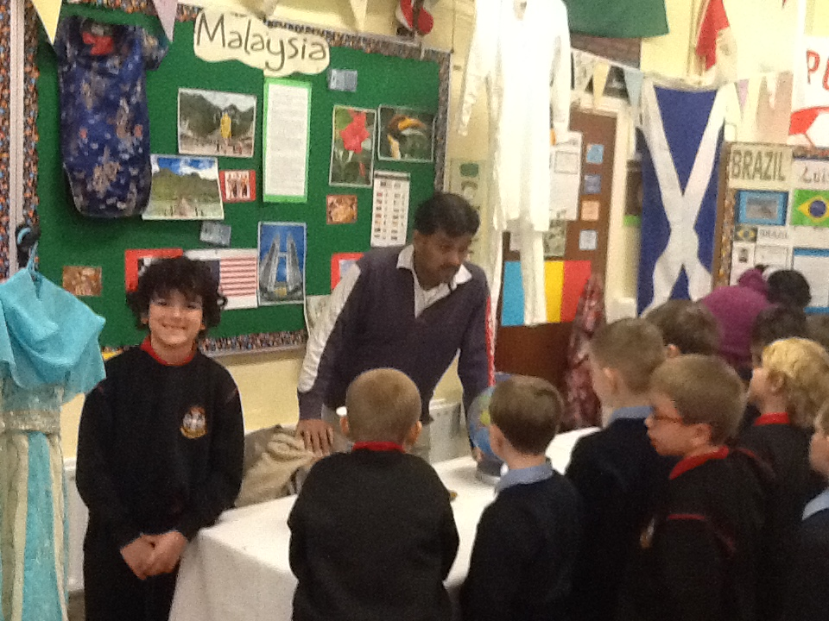
Multicultural Day

Slide 34
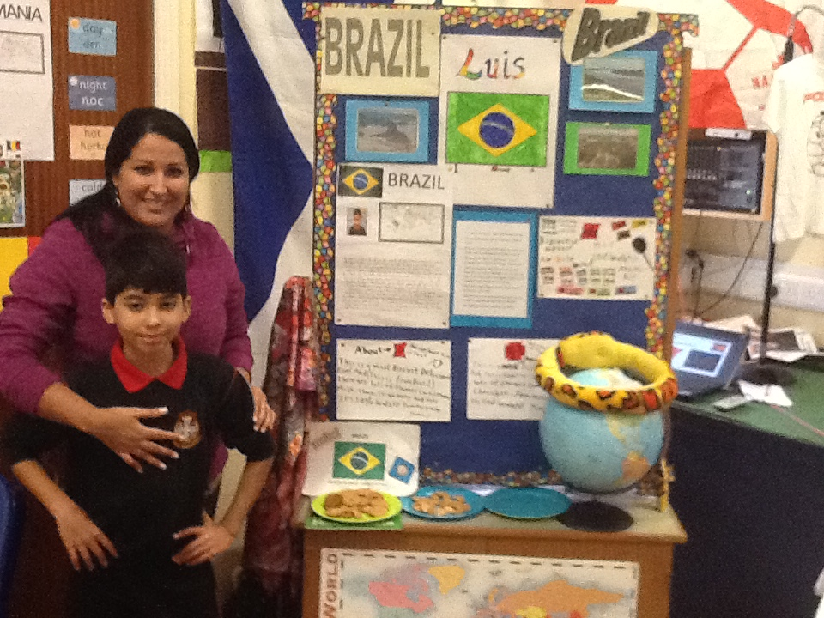
Multicultural Day

Slide 36
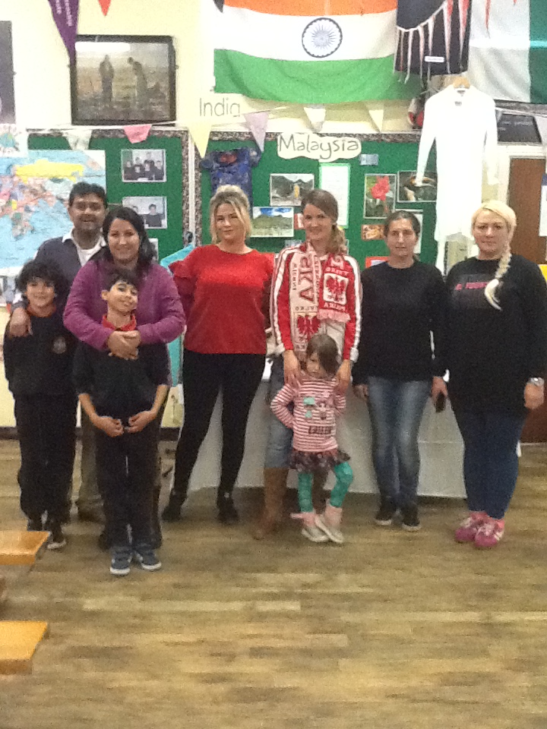
Multicultural Day

Slide 37
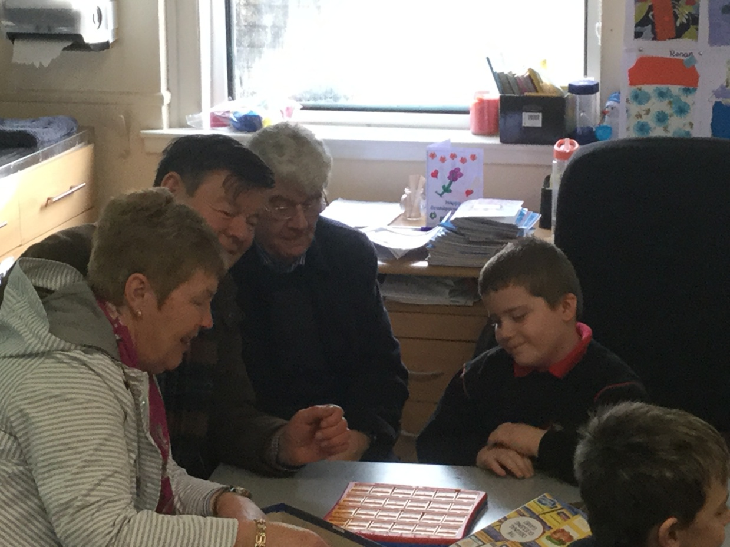
Grandparents’ Day

Slide 38
After school guitar

Slide 39
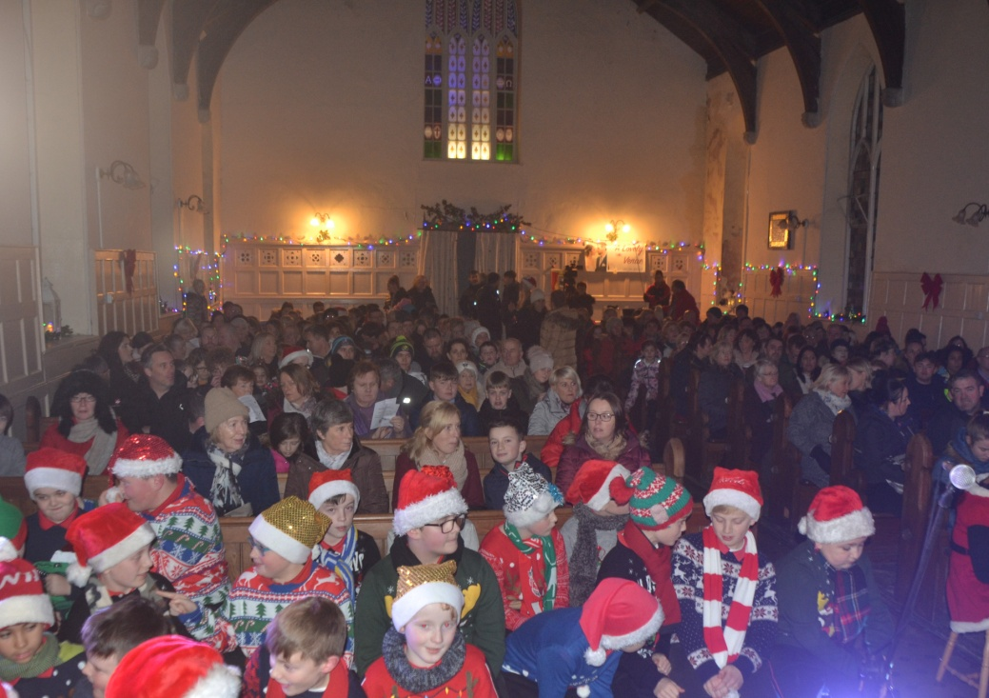
Concert at St.George’s

Slide 40
Concert at St.George’s

Slide 41
Thank you Canon Fitzgerald.

Slide 42
Winners of the Food Pyramid Competition

Slide 43
Helping others at St. George’s.

Slide 44
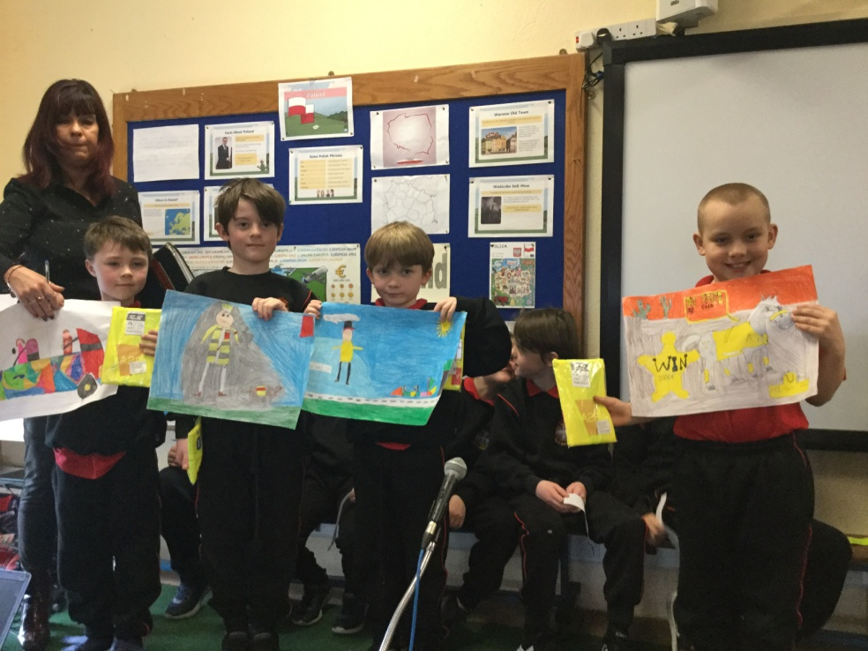
Seatbelt Sheriffs

Slide 45
After school Art and Crafts

Slide 46
Search and Rescue Dogs

Slide 51
Thanks to our hardworking Health Promoting School’s committee and to our staff co-ordinators.
Looking forward to continuing the great work in the next school year. Wishing you all and your families a very happy and safe summer break.
“Have Courage and be Kind”,
Best Wishes,
Ms. O’Regan

